Slide 1
Reducing Customer Churn for a Subscription-Based fitness app
Presented by
Ben Kovacevich

Slide 2

The TASk
A data driven approach to improving retention and boosting user engagement
Identify which users are most likely to cancel their subscriptions and why

Slide 3
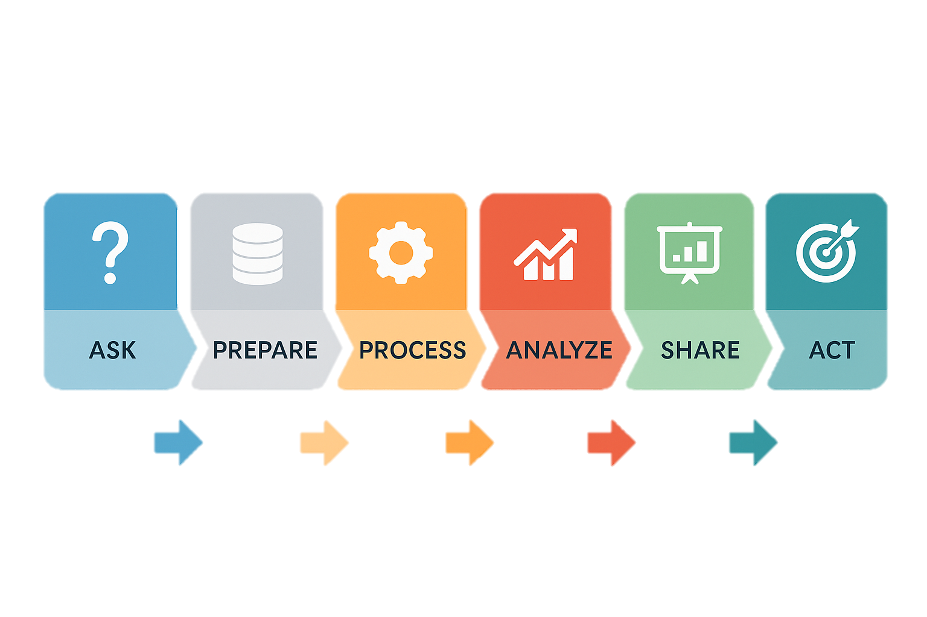
Dataset summary & Tools Used
1000 users from a simulated fitness subscription service
10 fields of collected data with 3 derived columns for deeper analysis
Tools Used
Excel (data cleaning & transformation)
Tableau (data viz)
Goal:
To identify behavioral patterns that correlate with user churn and provide actionable recommendations to improve retention.

Slide 4



Churn rate 50.4 % Retention Rate 49.6% Average Tenure 713 days
Key Metrics Summary
Despite a long average tenure, churn remains high – indicating many users delay cancellation.
Understanding behavior patterns behind churn is critical to improving long-term engagement.

Slide 5
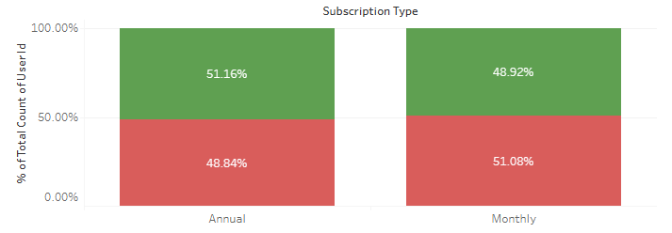
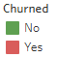
Churn by Subscription Plan
Monthly users churn at 51.08%, slightly higher than annual users at 48.84%
Annual subscribers retain slightly better – 51.16% retained vs 48.92% monthly
Suggest commitment level influences churn behavior
Annual plans offer slightly better retention, hinting that increasing long-term commitment can reduce churn.

Slide 6
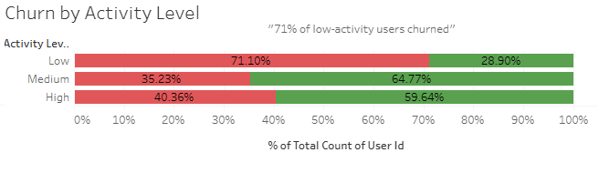
Churn by activity level
Low activity users churn at 71.1%
Medium activity users churn at 35.2%
High activity users churn at 40.4%
Strong negative correlation between workout frequency and retention
Users who average fewer than 1 workout per week are more than 70% likely to churn. Driving consistent weekly activity is critical to retention.

Slide 7
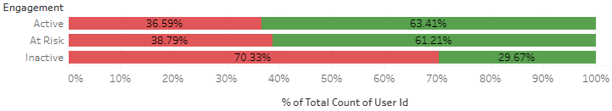
Churn by Engagement
Inactive users churn at 70.33%
At risk users churn at 38.79%
Active users churn at 36.59%
Engagement recency is a strong predicator of churn behavior
Churn risk increases drastically once users go 60+ days without logging in. Proactive re-engagement campaigns are essential before users become inactive.

Slide 8

Data Driven Retention Strategies
Re-engage At-Risk Users
Send automated reminders before users go inactive (30-59 days)
Offer rewards or challenges to boost re-login and workout rates
Boost Low Activity Users
Recommend personalized workout plans for users with <1 workout/week
Add motivational features: streak, badges, or trainer tips
Promote Annual Subscriptions
Annual user showed higher retention
Offer incentives (discounts or bonus content) to upgrade from monthly plans
Launch a Churn Prevention Campaign
Target segments with high churn risk (inactive + low activity + monthly)
Use messaging based on user behavior, not just demographics
By focusing on activity-driven segmentation and tailored interventions, the business can meaningfully reduce churn and improve customer lifetime value

Slide 9

Tools Used & Closing
Excel
Tableau
PowerPoint
Cleaned & explored data
Visualized churn trends
Presented findings
Thank you!
Questions or feedback welcome.
Ben Kovacevich
kovacevich34@gmail.com
https://www.linkedin.com/in/kovacevich34/
https://github.com/Kingserb34

